Slide 1

INT-312 Big Data Fundamentals
Unit 1-Installation of Hadoop

Slide 2
CONTENTS
Installation of Hadoop on Ubuntu

Slide 3
Installing Hadoop on Ubuntu in UTM
Step 1:
Installing Java
sudo apt-get install openjdk-8-jre-headless
Step 2:
Download Hadoop- https://hadoop.apache.org/releases.html
Step 3:
Configuring Hadoop’s Java Home
Verify JAVA availability with java -version
Check its presence in /usr/lib/jvm/

Slide 4
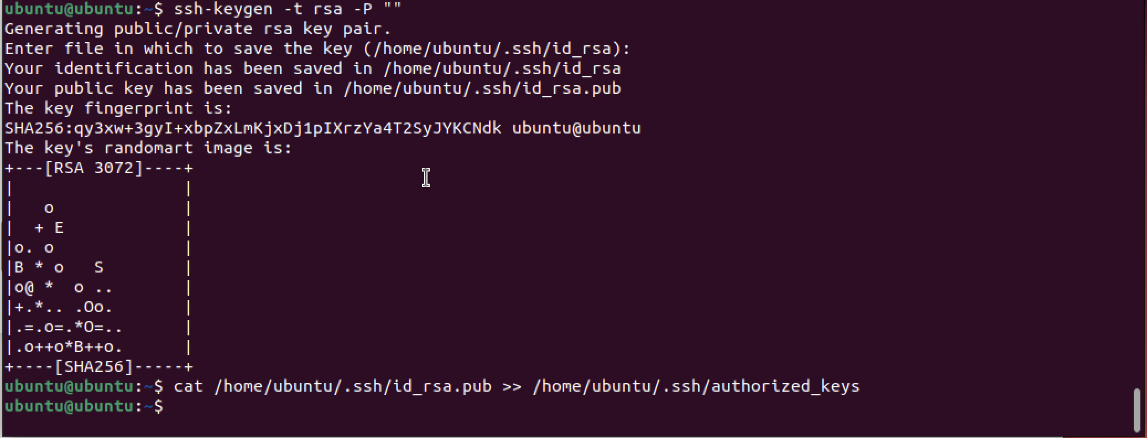
Installing Hadoop on Ubuntu in UTM
Step 4:
Installing SSH
sudo apt-get install ssh
Step 5:
Create and Setup SSH Certificates

Slide 5
Installing Hadoop on Ubuntu in UTM
Step 6:
Setup Configuration Files
~/.bashrc
hadoop-env.sh
core-site.xml
mapred-site.xml
hdfs-site.xml

Slide 6
Installing Hadoop on Ubuntu in UTM
Step 7:
Configuring bashrc-commands
export JAVA_HOME=/usr/lib/jvm/java-8-openjdk-arm64 export HADOOP_INSTALL=/home/ubuntu/hadoop-3.1.4 export PATH=$PATH:$HADOOP_INSTALL/bin export PATH=$PATH:$HADOOP_INSTALL/sbin export HADOOP_MAPRED_HOME=$HADOOP_INSTALL export HADOOP_COMMON_HOME=$HADOOP_INSTALL export HADOOP_HDFS_HOME=$HADOOP_INSTALL export YARN_HOME=$HADOOP_INSTALL export HADOOP_COMMON_LIB_NATIVE_DIR=$HADOOP_INSTALL/lib/native export HADOOP_OPTS=”-Djava.library.path=$HADOOP_INSTALL/lib”

Slide 7
Installing Hadoop on Ubuntu in UTM
Step 8:
Configuring hadoop-env.sh
export JAVA_HOME=/usr/lib/jvm/java-8-openjdk-arm64

Slide 8
Installing Hadoop on Ubuntu in UTM
Step 9:
Configuring core-site.xml
Add the following code within configuration tags
<property>
<name>hadoop.tmp.dir</name>
<value>/home/ubuntu/hadoop-3.1.4/tmp</value>
<description>A base for other temporary directories.</description>
</property>
<property>
<name>fs.default.name</name>
<value>hdfs://localhost:54310</value>
<description>The name of the default file system. A URI whose
scheme and authority determine the FileSystem implementation. The
uri's scheme determines the config property (fs.SCHEME.impl) naming
the FileSystem implementation class. The uri's authority is used to
determine the host, port, etc. for a filesystem.</description>
</property>

Slide 9
Installing Hadoop on Ubuntu in UTM
Step 10:
Configuring mapred-site.xml
Add the following code with configuration tags
<property>
<name>mapred.job.tracker</name>
<value>localhost:54311</value>
<description>The host and port that the MapReduce job tracker runs
at. If "local", then jobs are run in-process as a single map
and reduce task.
</description>
</property>

Slide 10
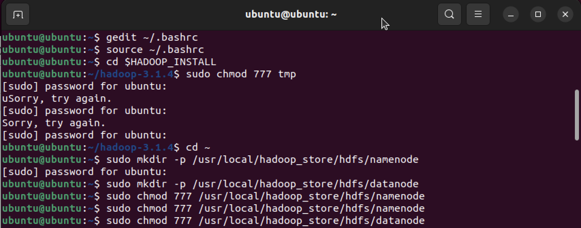
Installing Hadoop on Ubuntu in UTM
Step 11:
Configuring hdfs-site.xml
<property>
<name>dfs.replication</name>
<value>1</value>
</property>
<property>
<name>dfs.namenode.name.dir</name>
<value>file:/usr/local/hadoop_store/hdfs/namenode</value>
</property>
<property>
<name>dfs.datanode.data.dir</name>
<value>file:/usr/local/hadoop_store/hdfs/datanode</value>
</property>

Slide 11
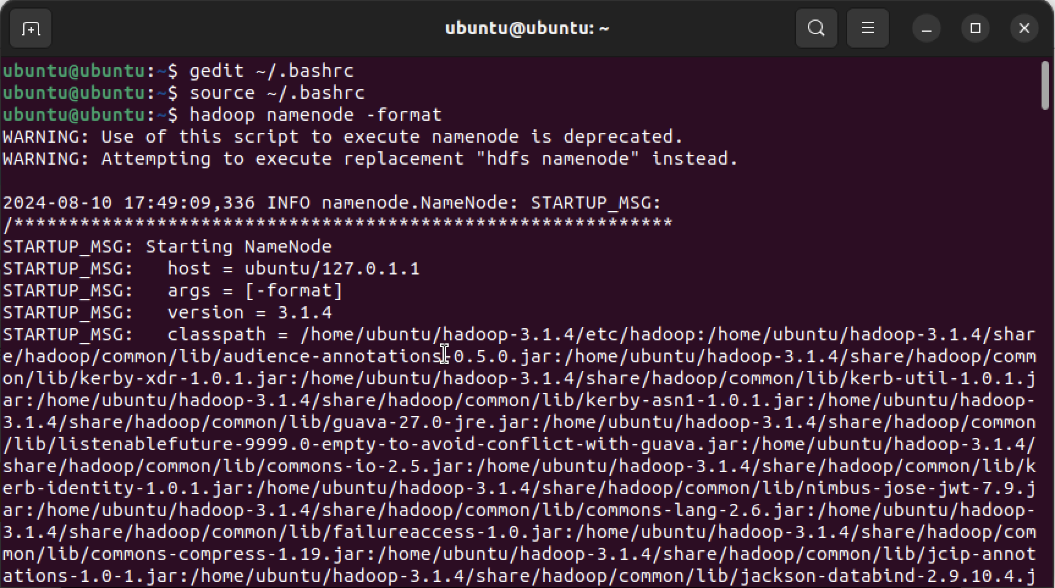
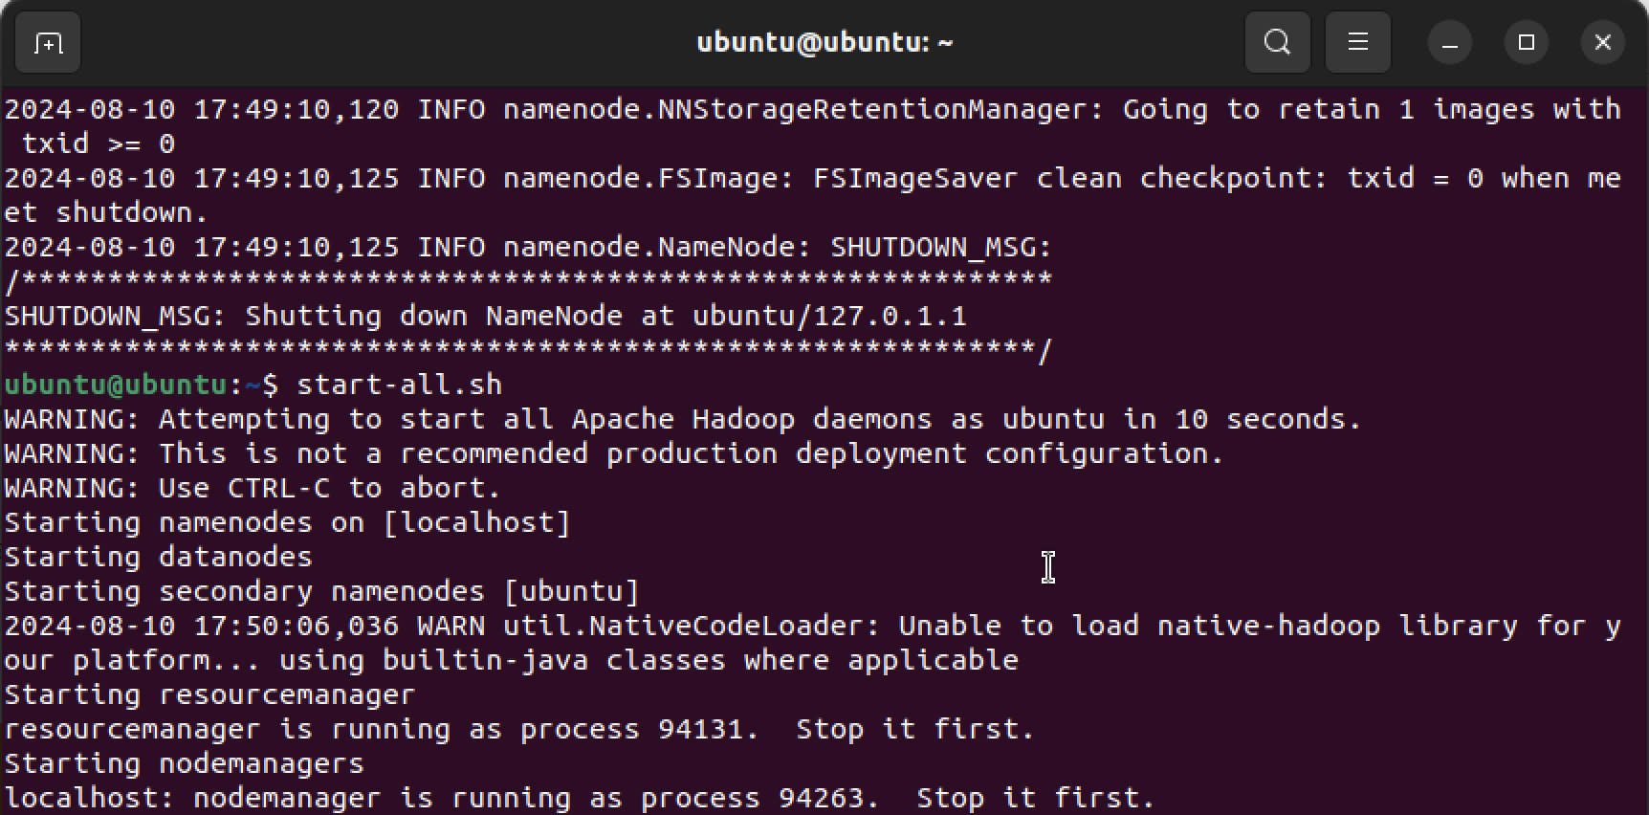
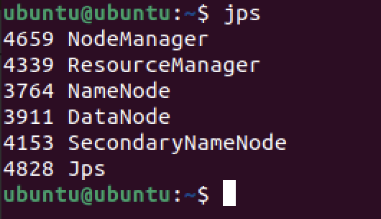
Installing Hadoop on Ubuntu in UTM
Step 12:
Format the New Hadoop Filesystem
hadoop namenode -format
Step 13:
Starting daemons of Hadoop
start-all.sh
Step 14:
Checking daemons
jps

Slide 12
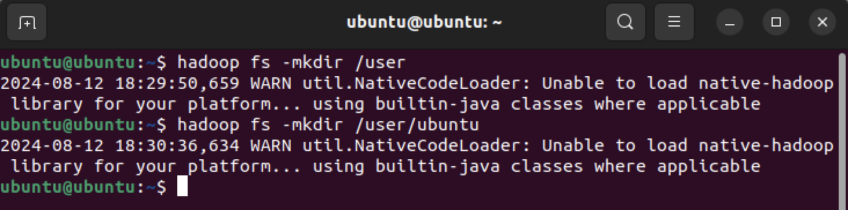
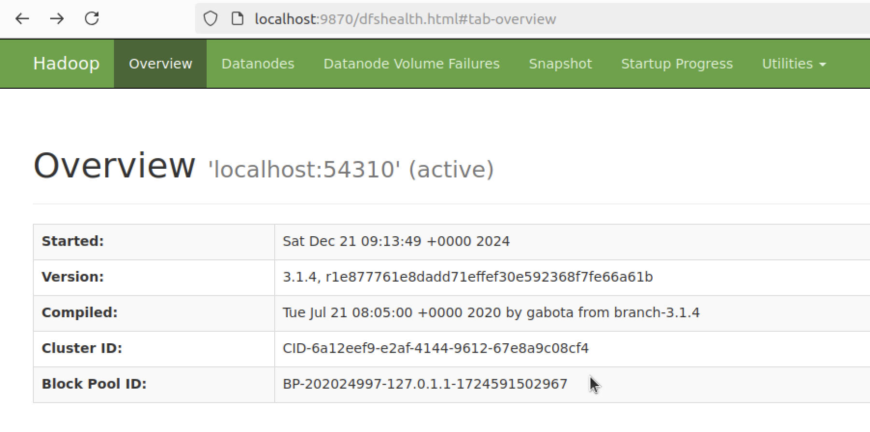
Installing Hadoop on Ubuntu in UTM
Step 15:
Create HADOOP HOME
hadoop fs -mkdir -p /user/ubuntu/
Step 16:
Checking HDFS Web UI
localhost:9870

Slide 13
THANK YOU

